Slide 1


GOJAN SCHOOL OF BUSINESS AND TECHNOLOGY
EDAPALAYAM, REDHILLS, CHENNAI-52.
Approved by A.I.C.T.E, New Delhi, Affiliated to Anna University, Chennai. (NAAC Accredited& An ISO 9001:2015 Certified Institution)
DEPARTMENT OF COMPUTER SCIENCE AND ENGINEERING
Project Title: Secure Web Hosting with HTTPS on Microsoft Azure
BATCH - 4
BATCH MEMBERS
SURESH KUMAR.D (110521104049)
VIMALESH.C (110521106303)
YOGESH BALAJI.K (110521104058)
RAMA KRISHNAN.A (110521104032)
UNDER THE GUIDANCE
Mrs ANJALI. S ( AP/CSE)

Slide 2
Problem Statement
In today’s fast-paced digital world, traditional systems often struggle to meet the growing demands of efficient information access, secure data handling, and real-time user interaction. Many existing solutions lack centralized access, automation, and a modern user interface, leading to inefficiencies, data inconsistency, and poor user experience. There is a need for a comprehensive platform that can provide streamlined operations, user-friendly interaction, and reliable data processing in a secure, scalable environment. The absence of dynamic web applications capable of offering seamless access, advanced features such as real-time monitoring, role-based access control, and integration with cloud services hinders operational efficiency in various domains. This project aims to bridge that gap by developing a secure, visually enhanced application, hosted on a virtual server, offering an advanced, interactive solution tailored to meet modern digital expectations.

Slide 3
Objective
To architect and deploy a secure and scalable web hosting environment utilizing the Microsoft Azure platform.
To seamlessly enable HTTPS for the hosted web application by leveraging Azure’s Managed SSL certificates, ensuring automatic renewal and simplified management.
To fortify the application’s security posture through the strategic implementation of Azure Web Application Firewall (WAF) to mitigate application-layer vulnerabilities and DDoS Protection to defend against volumetric denial-of-service attacks.
To optimize the web application’s global accessibility and performance by strategically employing Azure Front Door for intelligent traffic routing and enhanced content delivery.

Slide 4
Literature Survey
Related Works: Many systems currently employ traditional methods for resource management with limited automation and poor UI. Technologies Studied: Secure web application development with automated SSL. HTML5, CSS3, and JavaScript for frontend. SSL/TLS for secure communication. Improvement Over Existing Systems: Unlike conventional systems, our solution is highly secure, cloud-compatible, and optimized for real-time response.

Slide 5
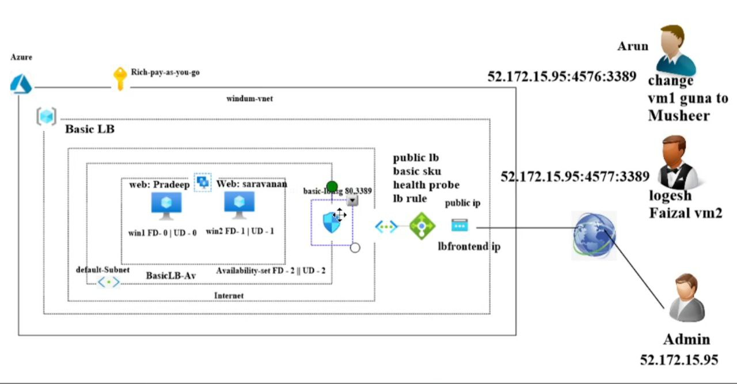
Proposed Architecture Diagram

Slide 6
Technology Stack
Operating System: Windows Server 2016 (VM-based setup for manual deployment and security configurations)
Languages: HTML, CSS, JavaScript (for static/dynamic frontend),PowerShell (for automation and Windows-based scripting)
Web & App Technologies: Azure App Service / IIS (Internet Information Services for manual deployment)
Security & Networking: SSL/TLS for encryption,Azure Web Application Firewall (WAF),Azure DDoS Protection,Azure Front Door (for global load balancing & HTTPS)
Monitoring & Automation: Azure Monitor and Application Insights,Custom PowerShell scripts or Azure Automation for certificate renewal and scheduled audits.

Slide 7
Implementation Details
Core Features Developed:
A virtualized secure hosting environment on Azure VM (Windows Server 2016)
Enabled HTTPS with Azure Managed Certificates.
Configured Azure Front Door for global traffic routing and load balancing
Set up WAF policies for OWASP-based threat mitigation and DDoS protection
Built automation scripts for SSL certificate renewal and logging

Slide 8
Code
{
"$schema": "https://schema.management.azure.com/schemas/2019-04-01/deploymentTemplate.json#",
"contentVersion": "1.0.0.0",
"parameters": {"webAppName": "type": "string","defaultValue":"securewebappdemo",
"metadata": {
"description": "Name of the Web App."
}},

Slide 9
"hostingPlanName": {
"type": "string",
"defaultValue": "securehostingplan",
"metadata": {
"description": "Name of the App Service Plan."
}},
"skuName": {
"type": "string",
"defaultValue": "F1",
"allowedValues": ["F1", "B1", "B2", "S1", "S2", "P1V2"],
"metadata": {
"description": "Pricing tier for the hosting plan."
} },

Slide 10
"location": {
"type": "string",
"defaultValue": "[resourceGroup().location]",
"metadata": {
"description": "Location for all resources." }}},
"resources": [{
"type": "Microsoft.Web/serverfarms",
"apiVersion": "2022-03-01",
"name": "[parameters('hostingPlanName')]",
"location": "[parameters('location')]",
"sku": {
"name": "[parameters('skuName')]",
"tier": "Free"},
"properties": {"reserved": false,"isXenon": false}
},

Slide 11
{
"type": "Microsoft.Web/sites",
"apiVersion": "2022-03-01",
"name": "[parameters('webAppName')]",
"location": "[parameters('location')]",
"dependsOn": [
"[resourceId('Microsoft.Web/serverfarms', parameters('hostingPlanName'))]"],
"properties": {
"serverFarmId": "[resourceId('Microsoft.Web/serverfarms', parameters('hostingPlanName'))]",
"httpsOnly": true } }],
"outputs": {
"webAppUrl": {
"type": "string",
"value": "[concat('https://', parameters('webAppName'), '.azurewebsites.net')]"
}}
}

Slide 12
CLOUD DEPLOYMENT
Deploy using Azure CLI:
az deployment group create \
--resource-group <BATCH4-resource-group> \
--template-file azuredeploy.json \
--parameters webAppName=<TESTWEB-app-name>

Slide 13
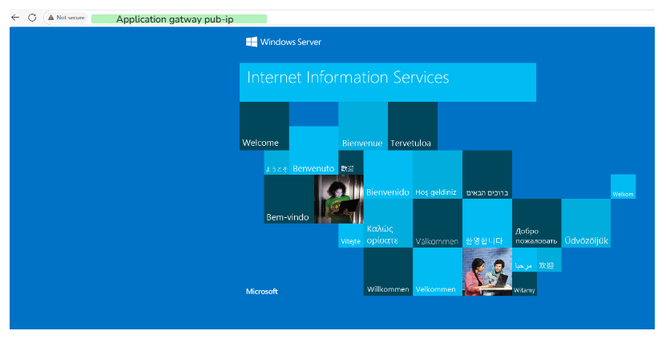
Sample OUTPUT

Slide 14
Result and Testing
Functional Testing:
Confirmed HTTPS padlock with valid certificate
Tested WAF blocking common web attacks (SQLi, XSS)
Performance Evaluation:
Page load tested with online tools (Gtmetrix and Google PageSpeed)
Azure Monitor shows uptime and resource usage.

Slide 15
Challenges Faced & Solutions
Challenges:
Configuring IIS manually on Windows Server for Python app
SSL auto-renewal on a self-managed VM without native Azure App Service
Handling DNS propagation and domain verification
Solutions:
Used Flask with Waitress + IIS reverse proxy for deployment
Scheduled PowerShell scripts or used Win-ACME for SSL renewals
Used Azure DNS or GoDaddy for faster verification with CNAME/A records

Slide 16
Future work & Remaining Tasks
Integrate a full-stack Python web app with database support
Extend WAF rules to include geofencing and custom bot filtering
Enable Azure Sentinel or Defender for advanced threat analytics
Add user access authentication (e.g., Azure Active Directory)
Document the full deployment steps in a technical guide

Slide 17
Conclusion
In conclusion, this project successfully demonstrates the creation of a robust cloud-based web hosting architecture on Microsoft Azure that prioritizes security, operational automation, and optimal performance. By strategically integrating Azure’s comprehensive suite of services, including App Service for hosting, Managed SSL for simplified HTTPS, WAF and DDoS Protection for layered security, and Front Door for enhanced global delivery, the resulting solution offers a reliable, fast, and secure platform for serving web content. This approach effectively addresses common vulnerabilities and complexities associated with conventional hosting environments and presents a scalable and adaptable model for real-world, production-grade web applications.

Slide 18
References
T. Sheela et al., “Secure Online Examination System on Azure Cloud,” IEEE ICCCT 2021.
T. Benjaponpitak et al., “Containerized App Migration Across Clouds,” IEEE INFOCOM 2020.
Q. Jacquemart et al., “DNS Data for Cloud Deployment Analysis,” IEEE TMA 2019.
Microsoft Azure Official Documentation (App Service, Front Door, SSL/TLS, WAF)

Slide 19
THANK YOU

